Slide 1

Offering Microsoft Azure Stack Hub Resources
Microsoft Azure Stack Hub Marketplace
This work is licensed under a Creative Commons Attribution - ShareAlike 4.0 International Public License

Slide 2
Agenda
Marketplace overview
Syndication and Marketplace overview
Marketplace solution types
Using existing images, extensions, and solutions
Marketplace Scenarios
Connected
Partially Connected / Disconnected

Slide 3
Azure Marketplace Overview

Slide 4

Goal: Transform options into consumable solutions
Availability set
Load Balancer
Compute
Blob Storage
VM
Extensions
SQL

Slide 5
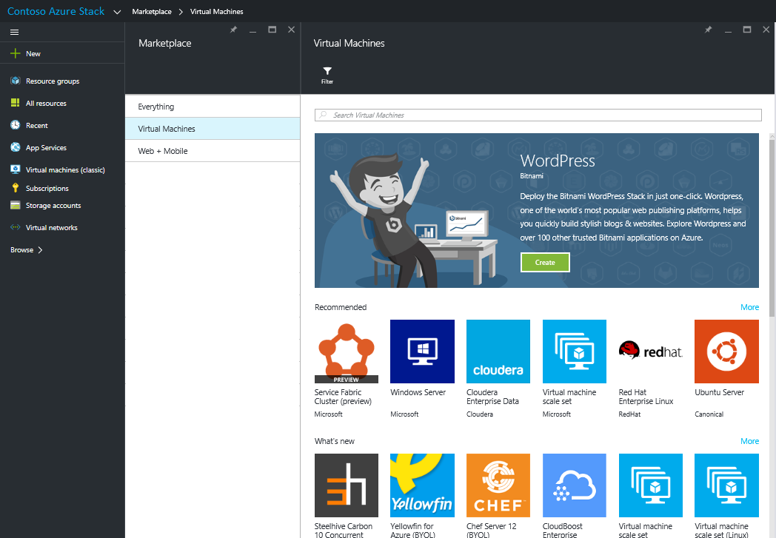
Azure Marketplace
Azure Marketplace is an online store that contains certified, open source, and community software applications, developer services, and data which are pre-configured to run in Microsoft Azure (and Azure Stack Hub)
https://azure.microsoft.com/en-us/marketplace

Slide 6
Azure Marketplace considerations
It should not be expected that all Azure Marketplace images and VMExtensions will be present in Azure Stack Hub
Azure Stack Hub will have a syndication service which will allow for specified images and VMExtensions to be downloaded and included in Azure Stack Hub deployments
Dependencies exist for ISV Marketplace images. Each ISV needs to mark images as "Azure Stack Hub Capable"
If you wish to deploy a solution with dependencies it should be developed and deployed as a “self-contained” image
It is ever evolving so see what’s new versus deprecated

Slide 7
Azure Marketplace More than 3,500 apps and growing
Microsoft Azure Certified Virtual Machines
Community templates and images
Web Apps, APIs, Connectors, and Data Services
Container Apps
Vertical solution and finished apps
360+
1,100+
2,100+
30+
Coming soon…
Azure Marketplace items available for Azure Stack Hub - Azure Stack Hub | Microsoft Docs

Slide 8
Azure Stack Hub Marketplace syndication
ISV
Cloud Administrator
End customer
Publish to Azure Stack Hub Marketplace
Subscribe to Azure Marketplace items
Download items
Add custom content
Publish items to customers
Deploy and use items from local Marketplace
Register Azure Stack Hub with Azure for Marketplace Syndication - Azure Stack Hub | Microsoft Docs

Slide 9
What is syndication?
ISVs publish content
Azure
Azure Stack Hub Marketplace Service
Azure Stack Hub Resource Provider
Repository
Azure Stack
Azure Stack Hub Marketplace Tenant Experience
Azure Stack Hub Marketplace Administration
Repository

Slide 10

Registration process
Azure Stack Hub
Azure
Get registration token
Create registration object
Input activation key
Retrieve activation key

Slide 11
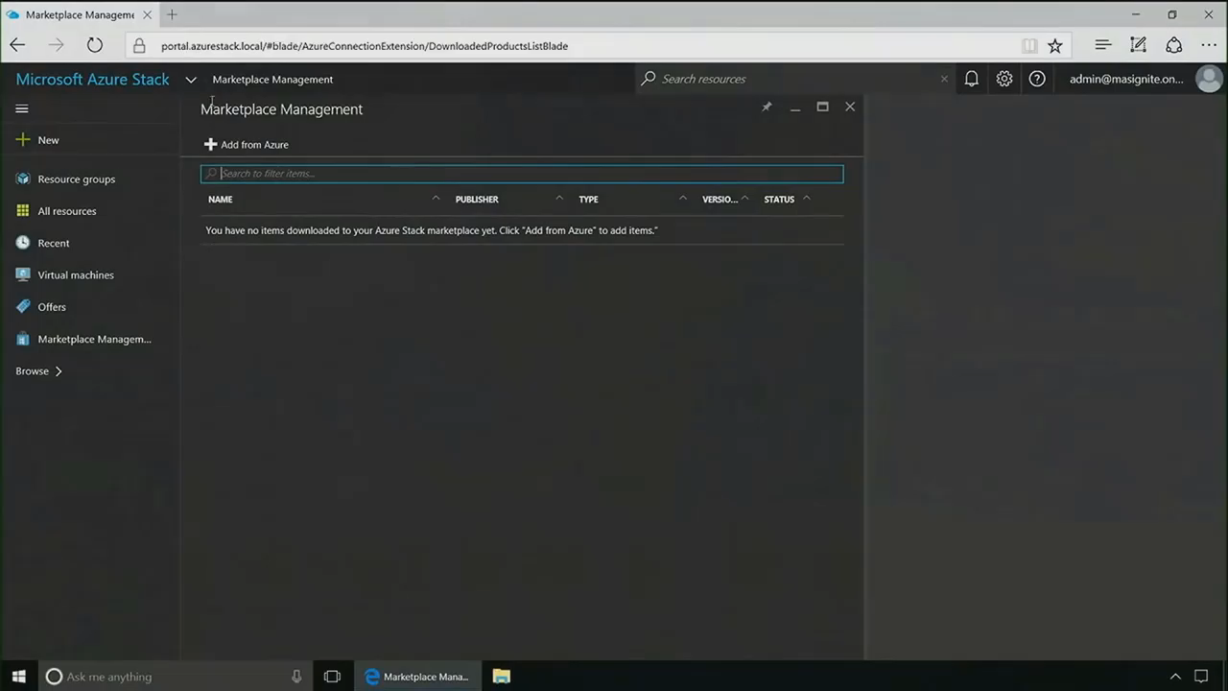

Slide 12
Why be connected?
Marketplace syndication*
Option to do consumption billing
Option to send telemetry to help improve the product
More opportunities for future value-added services
E.g. can we regularly collect environment data to predict hardware failures before the customer is even aware?
With the consumption data in Azure Stack Hub, this also opens up the possibility of querying it independently for capacity planning and/or historical usage reporting…
*Syndication is available in a limited way for disconnected customers

Slide 13
BYOL considerations: Who owns the license?
Enterprises
The license should be owned by the end customer
ISVs
ISVs should have an out-of-band mechanism to license their software
Service Providers
End tenants would need to bring license - or - This would need to be provided for them as part of their agreement

Slide 14
Why is the Marketplace important?
Functionality
Discovery
Deployment
Integration
Your customers require additional cloud platform functionality
Finding and procuring the right software is often problematic
Your customers require a scalable deployment mechanism
Third party software must easily integrate with existing solutions
App ecosystems offer complementary software that provides additional platform functionality
App marketplaces provide a one-stop shop to find, try, and buy software
App marketplaces enable customers to easily configure and deploy third party software
App marketplaces ensure software is compatible and can integrate with existing cloud platform solutions

Slide 15
Azure Stack Hub Marketplace Solution Types

Slide 16

Marketplace solution types
Existing
Images
Extensions
Resource Providers
Solutions
Existing pre-built images/solutions
Vendor Virtual Machine images
Vendor VM extensions
Azure Stack PaaS Offerings
Vendor pre-built solutions
Getting started…

Slide 17
Marketplace solution types
Existing
Images
Existing pre-built images/solutions
Vendor Virtual Machine images

Slide 18
What is the Platform Image Repository?
Platform Image Repository (PIR)
Maintains the list of images available for tenants to use when deploying a new Virtual Machine
Enables administrators to make VM images, such as their organization’s custom VHD, available to their tenants
Images can be referenced by ARM templates or added to the Azure Marketplace in Azure Stack Hub
Guest Artifact Repository (GAR)
Holds the extension binaries which can be installed in a Virtual Machine

Slide 19
Why add images to the PIR?
A need to provide commercially available images to enhance tenant experience (Ubuntu, Windows Server, CentOS, etc.)
A need to provide internally curated custom images to be utilized by tenants
A need to provide a requested images or solutions currently not available as part of Azure Marketplace

Slide 20
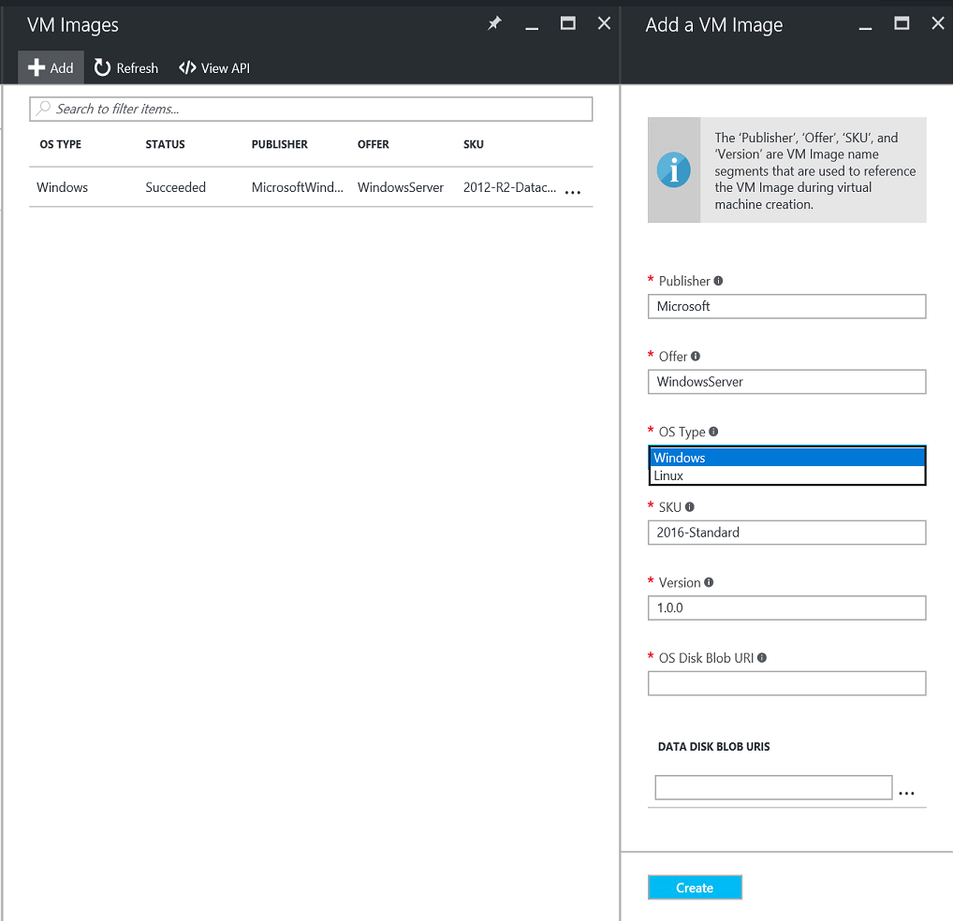
Adding images
Add your custom Virtual Machine images to Azure Stack Hub
Images can show up in the tenant Marketplace
From Marketplace, customers can easily provision VMs based off these images

Slide 21
Marketplace solution types
Extensions
Vendor VM extensions
Getting started…

Slide 22
Extensions
Azure VM extensions apply post-deployment configuration and automation tasks to VM images
Post-install software installation
Anti-virus protection
Docker configuration
Can be run by using the Azure CLI, PowerShell, Azure Resource Manager templates, and the Azure portal
Can be bundled with a new Virtual Machine deployment or run against any existing system
In Azure Stack Hub, these are treated no differently than images

Slide 23
Marketplace solution types
Resource Providers
Azure Stack PaaS Offerings
Getting started…

Slide 24
Resource Providers (RP)
Newer PaaS offerings utilizing this model
Consistent method for deployment versus each one unique
Less Configuration to get it started
Making this method consistent with the other solution types
Prerequisites
Install latest version of Azure Stack Tools
Marketplace Syndication done
Download Resource Provider and dependent packages as required by the RP
Update Azure AD Home directory. New application required to be registered
These need to be done only once, for all RPs
Current RPs utilizing the Marketplace Deployment
Event Hubs
IoT Hub

Slide 25
Marketplace solution types
Solutions
Vendor pre-built solutions
Getting started…

Slide 26
What are solutions?
Azure content
Custom content
Fit-and-finish solution providing a platform or service on OS images and third-party software
Multi-image or single image based
Designed and supported by ISV and syndicated through Azure Marketplace
Fit-and-finish solution providing a platform or service on OS images and first or third-party software
Multi-image or single image based
Designed and supported by customers, built using native Azure Resource Manager tools

Slide 27
What is required for a solution?
ARM Templates
VM Extensions
Artifacts
e.g. VM Image
Gallery Packages
ARM Template
Icons
Marketing text
Manifest file which describes how the UI will look

Slide 28



Gallery packages: Files | Folders
Solution
DeploymentTemplates
azuredeploy.json
Icons
Small.png
Medium.png
Large.png
Wide.png
Screenshot.png
strings
resources.resjson
manifest.json
UIDefinition.json
Gallery Packages
https://docs.microsoft.com/en-us/azure/azure-stack/azure-stack-create-and-publish-marketplace-item

Slide 29
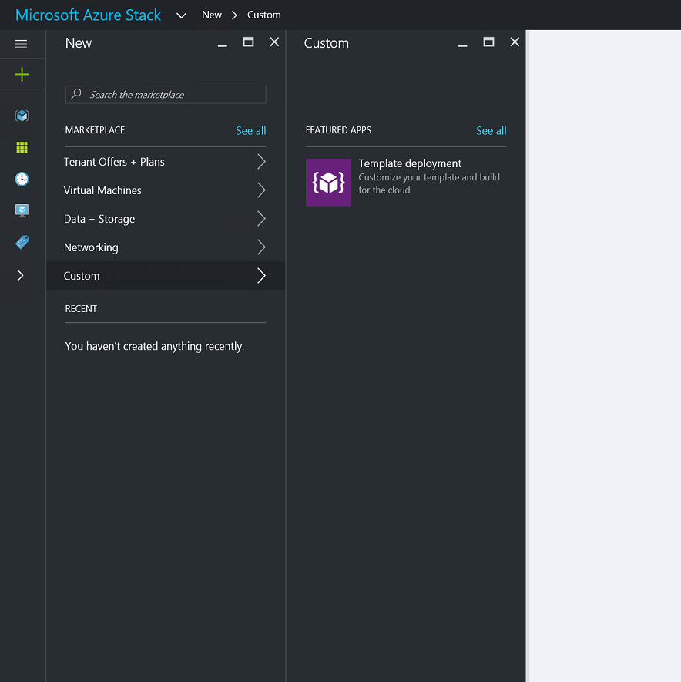
Gallery packages: ARM
Instructions available online for how to create and publish a custom Marketplace item
Anything that can be represented by an ARM template can be added to your Azure Stack Hub Marketplace
Use PowerShell to add Marketplace items to Azure Stack Hub
Gallery Packages
Add-AzureRMGalleryItem -SubscriptionId <AdminSubID> -GalleryItemUri <Link to item you created> -Apiversion "2015-04-01" –Verbose

Slide 30

Latest additions
AKS Engine
Red Hat Virtual Machines
Commvault
Qualys Virtual Scanner
Check Point CloudGaurd
New Marketplace Items - Azure Stack Hub | Microsoft Docs

Slide 31
Azure Stack Hub Marketplace Scenarios

Slide 32
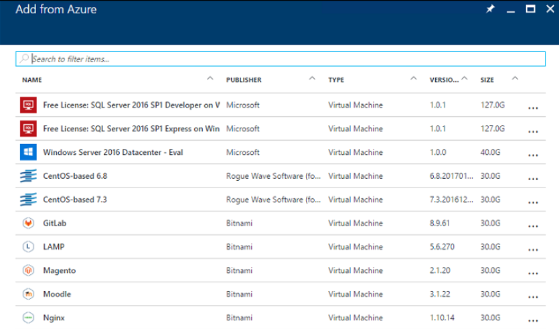
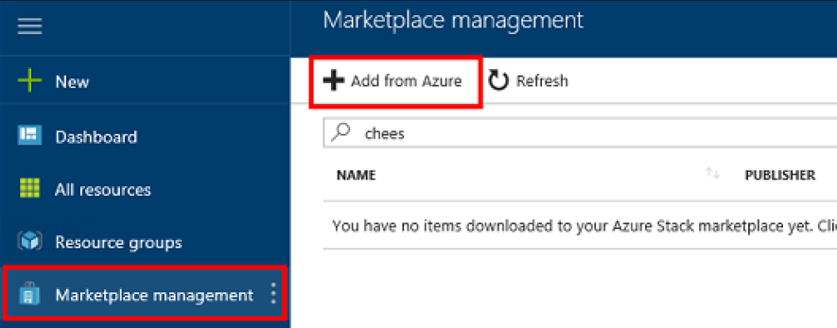
Connected scenario
Must be connected to Internet
Use Azure Stack Hub Portal to locate and Download Items

Slide 33
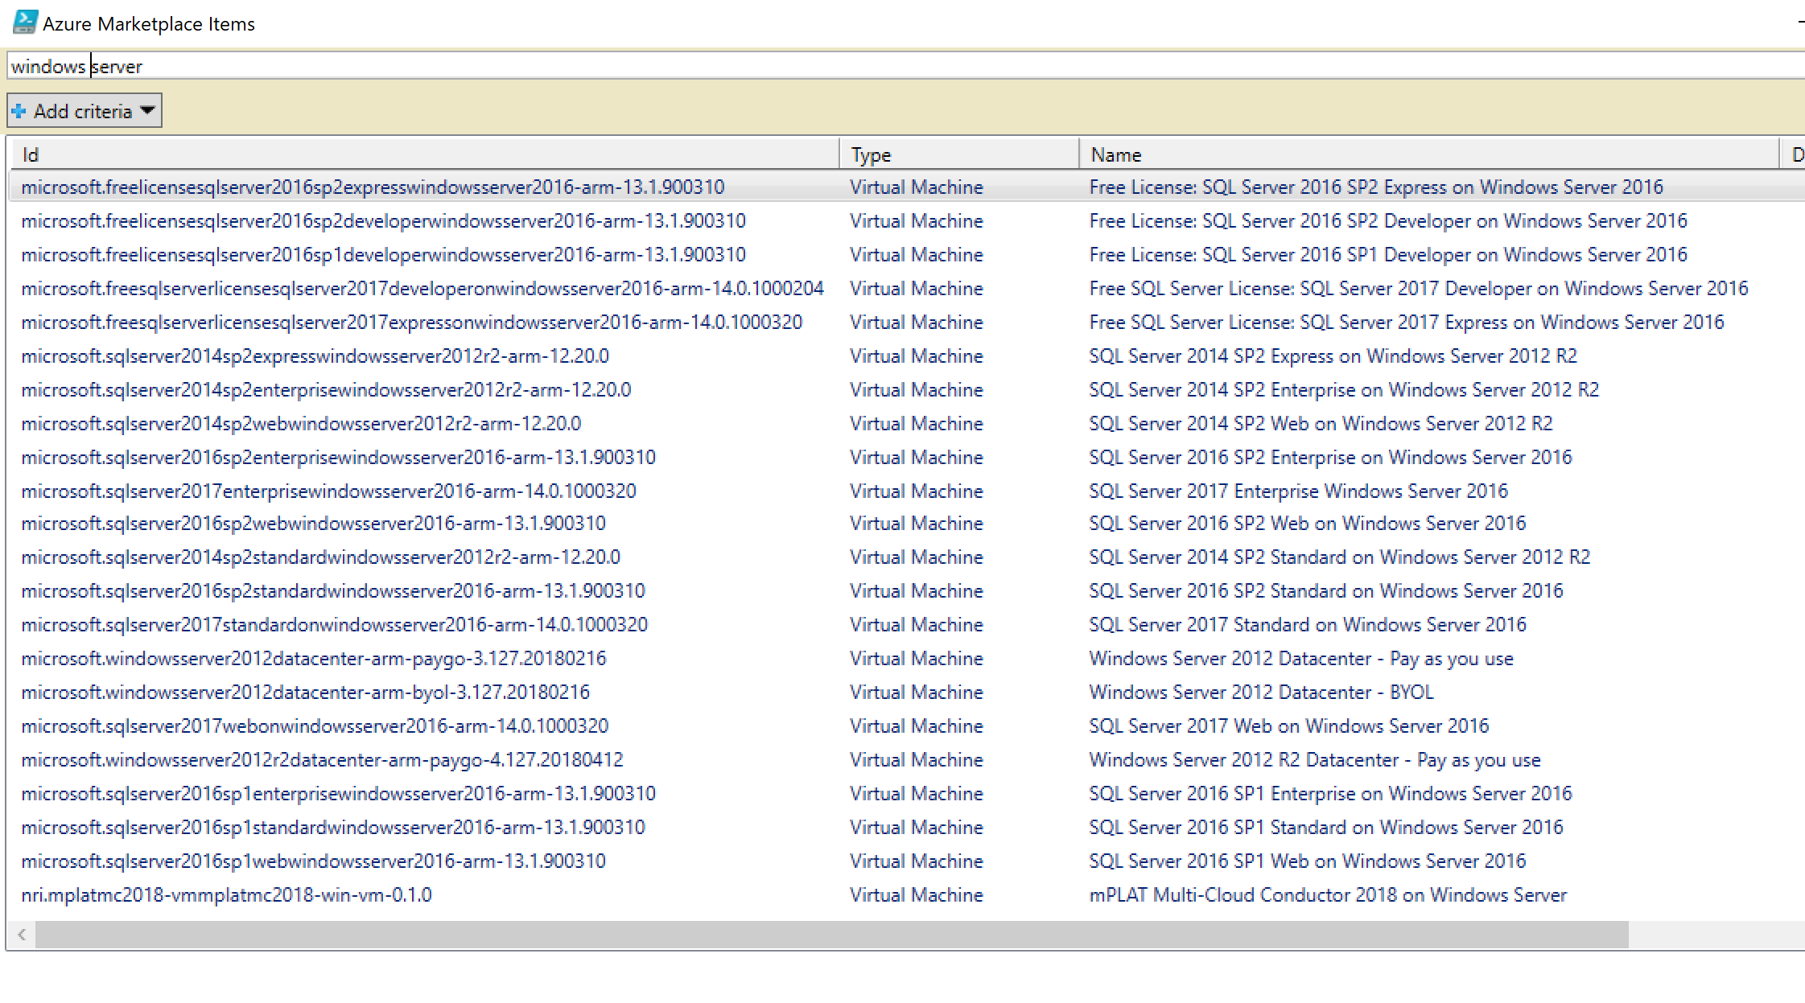
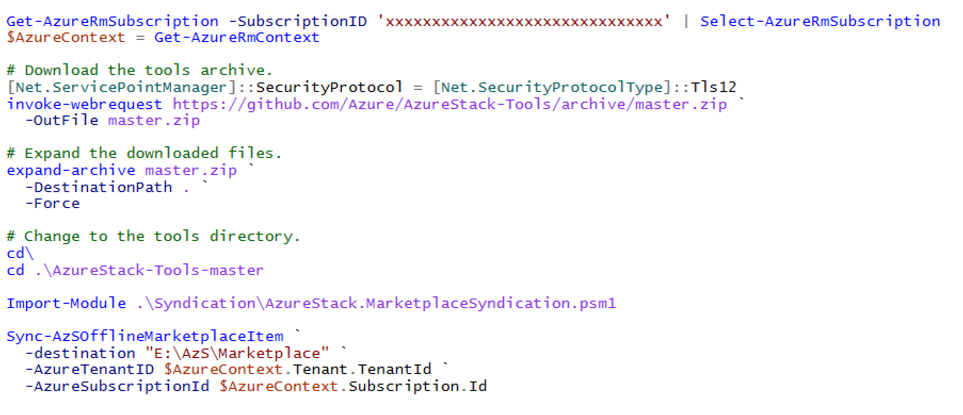
Disconnected scenario
Very Limited Internet Access or Disconnected
Use Syndication Tool, then
Download from Azure Marketplace
Then move files to upload physically
Publish Files to Azure Stack Hub Marketplace
Pre-requisites
Azure Stack Hub Registered
Azure Stack Hub PowerShell Module version 1.2.11 or greater
Configure Azure Stack Hub Operator for PowerShell
Publicly Available Container in Azure Stack Hub

Slide 34
Questions?

